Slide 1

KGISL
KGISL INSTITUTE OF TECHNOLOGY COIMBATORE

Slide 2

PY-EXPO
PROJECT TITTLE : RESTAURANT BILL GENERATION
TEAM :25
TEAM MEMBERS :PRAVEEN RAJ.C
SHIVA PRAKASH.S
VIKRANT VIKAASA.V
SAKTHI VIHAAS.M
SAHAANA.K
SWETHA.S

Slide 3
Restaurant Bill Generation

Slide 4
Applications:
This Restaurant Billing System Project is written in Python language.
The project record contains a python script (restaurant_billing.Py).
This is a easy GUI based totally application that’s very easy to understand and use.
It makes use of Tkinter module for the GUI.
Talking about the application, the consumer just has to choose among the food and drinks items, enter the amount and click on on the overall button to view the total price.
The consumer can view the full receipt of their objects which shows receipt quantity and Variety of their foods / drinks /gadgets with the entire amount.
Here, the whole bill of the customer consists of tax and service prices too.

Slide 5
Package Used:
Tkinter is an open-source Python Graphic User Interface (GUI) library well known for its simplicity.
It comes pre-installed in Python’s new versions, so you don’t even need to think about installing it.
These characteristics make it a strong position for beginners and intermediates to begin with.
Tkinter can be used for larger-scale projects.

Slide 6
ADVANTAGES
Is really easy to understand
Is more flexible and stable than other toolkit.
Advantages of using Tkinter
It’s fast to implement as compared to any GUI toolkit.
Provides three geometry managers: place, pack, and grid.

Slide 7
MODULES USED
TKINTER
INBUILT MODULE
TIME
RANDOM
DATE & TIME

Slide 8
Random module can be used to perform random actions such as generating random numbers for a list or string.
2.Random
Datetime module supplies classes to work with date and time. These classes provide a number of functions to deal with dates, times and time intervals.
3.Datetime
Time module allows to work with time in Python. It allows functionality like getting the current time, pausing the Program from executing.
4.Time

Slide 9
OUTPUT

Slide 10
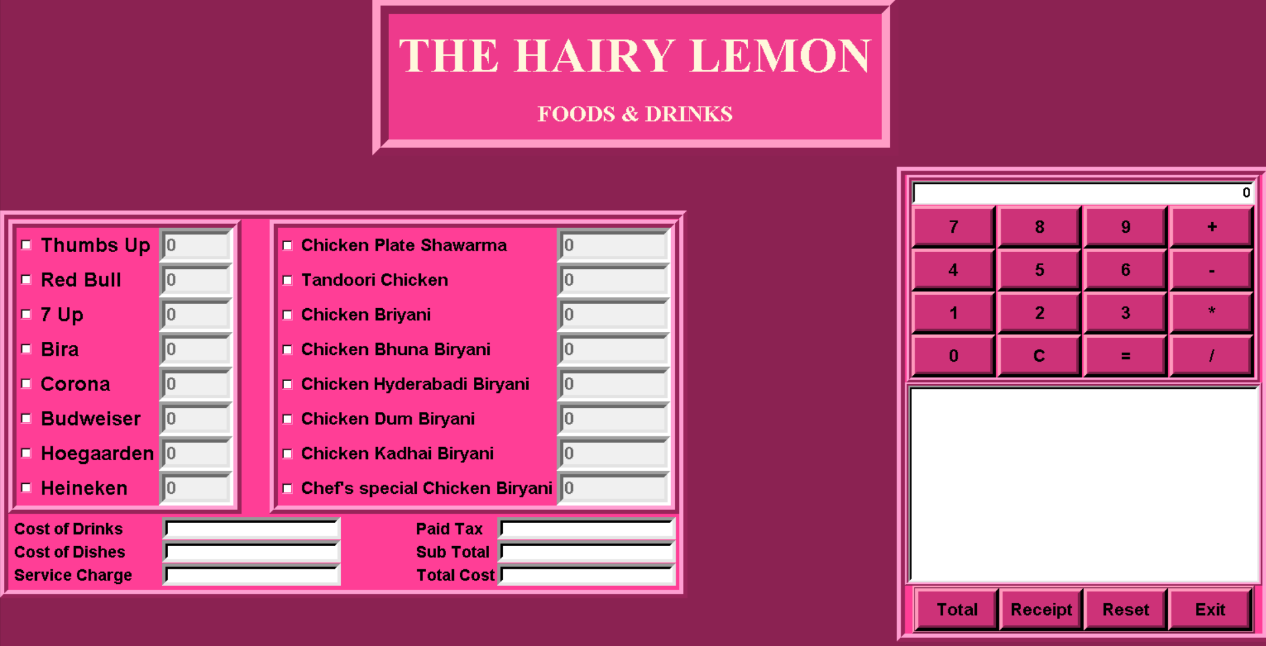

Slide 11
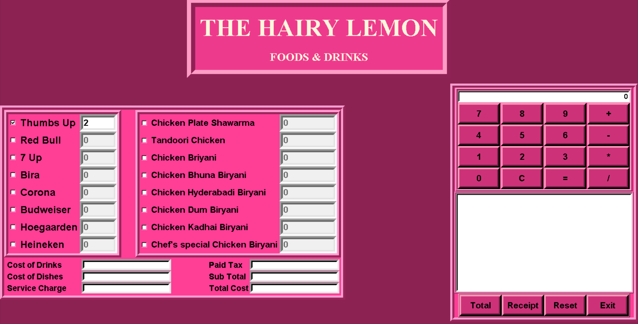

Slide 12
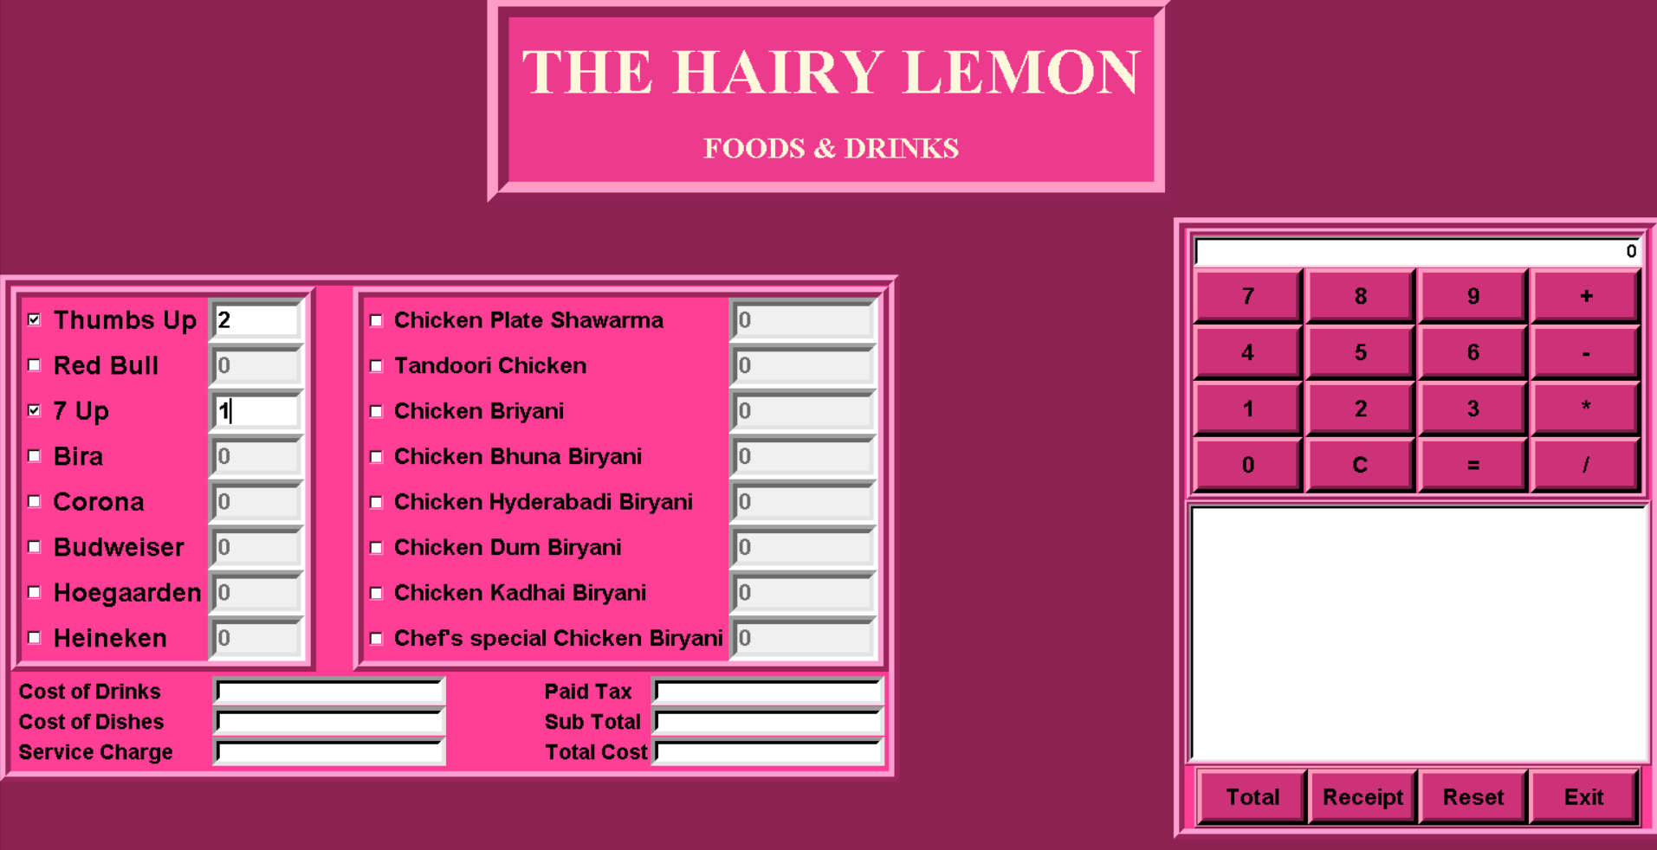

Slide 13


Slide 14


Slide 15


Slide 16
THANK YOU

